Slide 1


MYSQL project
HOSPITAL MANAGEMENT ANALYSIS
- Sangeetha s
Status Report

Slide 2
OBJECTIVE
The primary objective of hospital management analysis is to optimize the efficiency and effectiveness of healthcare delivery within a hospital or healthcare system.
This involves assessing various aspects such as resource allocation, patient flow, quality of care, and financial performance to enhance patient outcomes while managing costs and resources effectively.

Slide 3
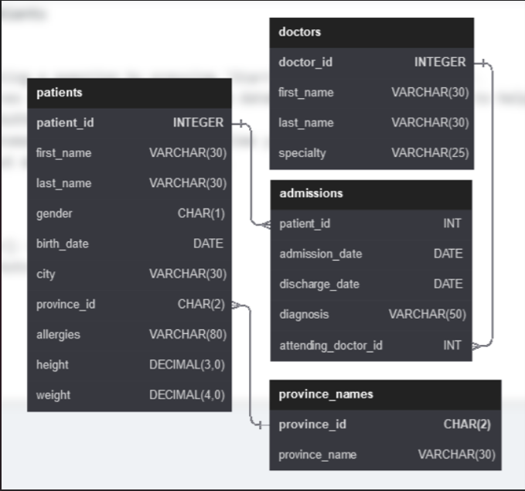
HOSPITAL MANAGEMENT DATABASE SCHEMA

Slide 4
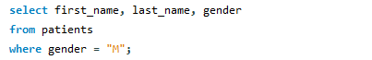
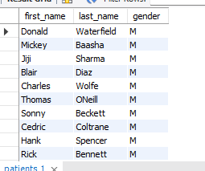

QUESTION - 1
Show first name, last name, and gender of patients whose gender is “M”.

Slide 5
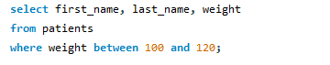

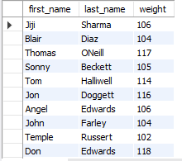
QUESTION – 2 show first name and last name of patients that weight within the range of 100 to 120
Notes:
hgghygvhsxha

Slide 6
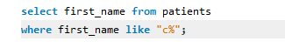
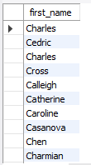
QUESTION – 3 show first name of patients that start with the letter "c"

Slide 7
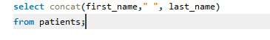
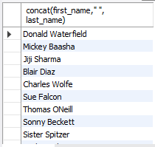
QUESTION – 4 show first name and last name concatinated into one column to show their full name
Notes:
hgghygvhsxha

Slide 8

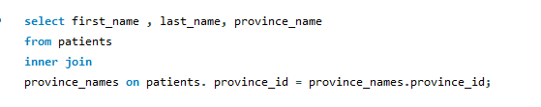
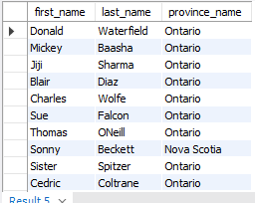
QUESTION – 5
show first name, last name, and the full province name of ecah patients
Year
Year
Yar
Year

Slide 9
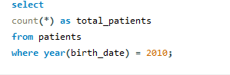

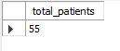
QUESTION – 6
show how many patients have a birthdate with 2010 as the birth year

Slide 10
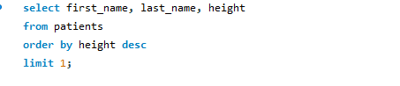
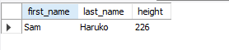
QUESTION – 7
show the fist name, last name , and height of the patient with the greatest height

Slide 11
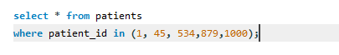
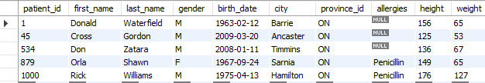
QUESTION – 8
show all columns for patients who have one of the following patient_ids:1,45,534,879,1000.
99%
Professional
87%
Career

Slide 12

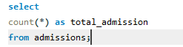

QUESTION – 9
show number of admission
02
Ingredients
About
03
Ingredients
About

Slide 13
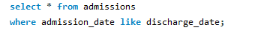
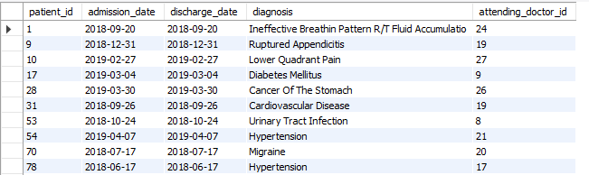
QUESTION – 10
show all the columns from admissions where the patient was admitted and discharged on the same day

Slide 14

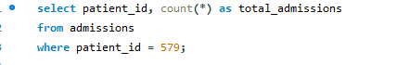
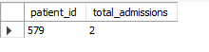
QUESTION – 11
show the patient id and the total number of admission for patient_id 579

Slide 15

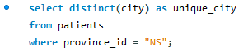

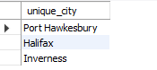
QUESTION – 12
based on the cities that our patients live in, show unique cities that are in province_id "NS“.
Subtitle 2

Slide 16
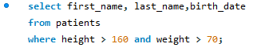
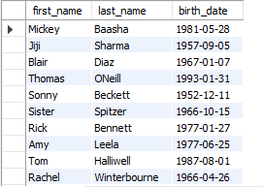
QUESTION – 13
write a query to find the first name, last name and birth date of patients who has height greater than 160 and weight greater than 70

Slide 17
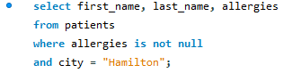
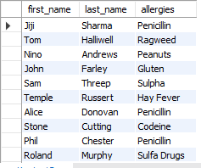
QUESTION – 14
write a query to find list of patientsfirst name, last name, and allergies where allergies are not null and are from the city of "hamilton"

Slide 18
THANK
YOU !!

